Slide 1
Karakia Prayer

Slide 2
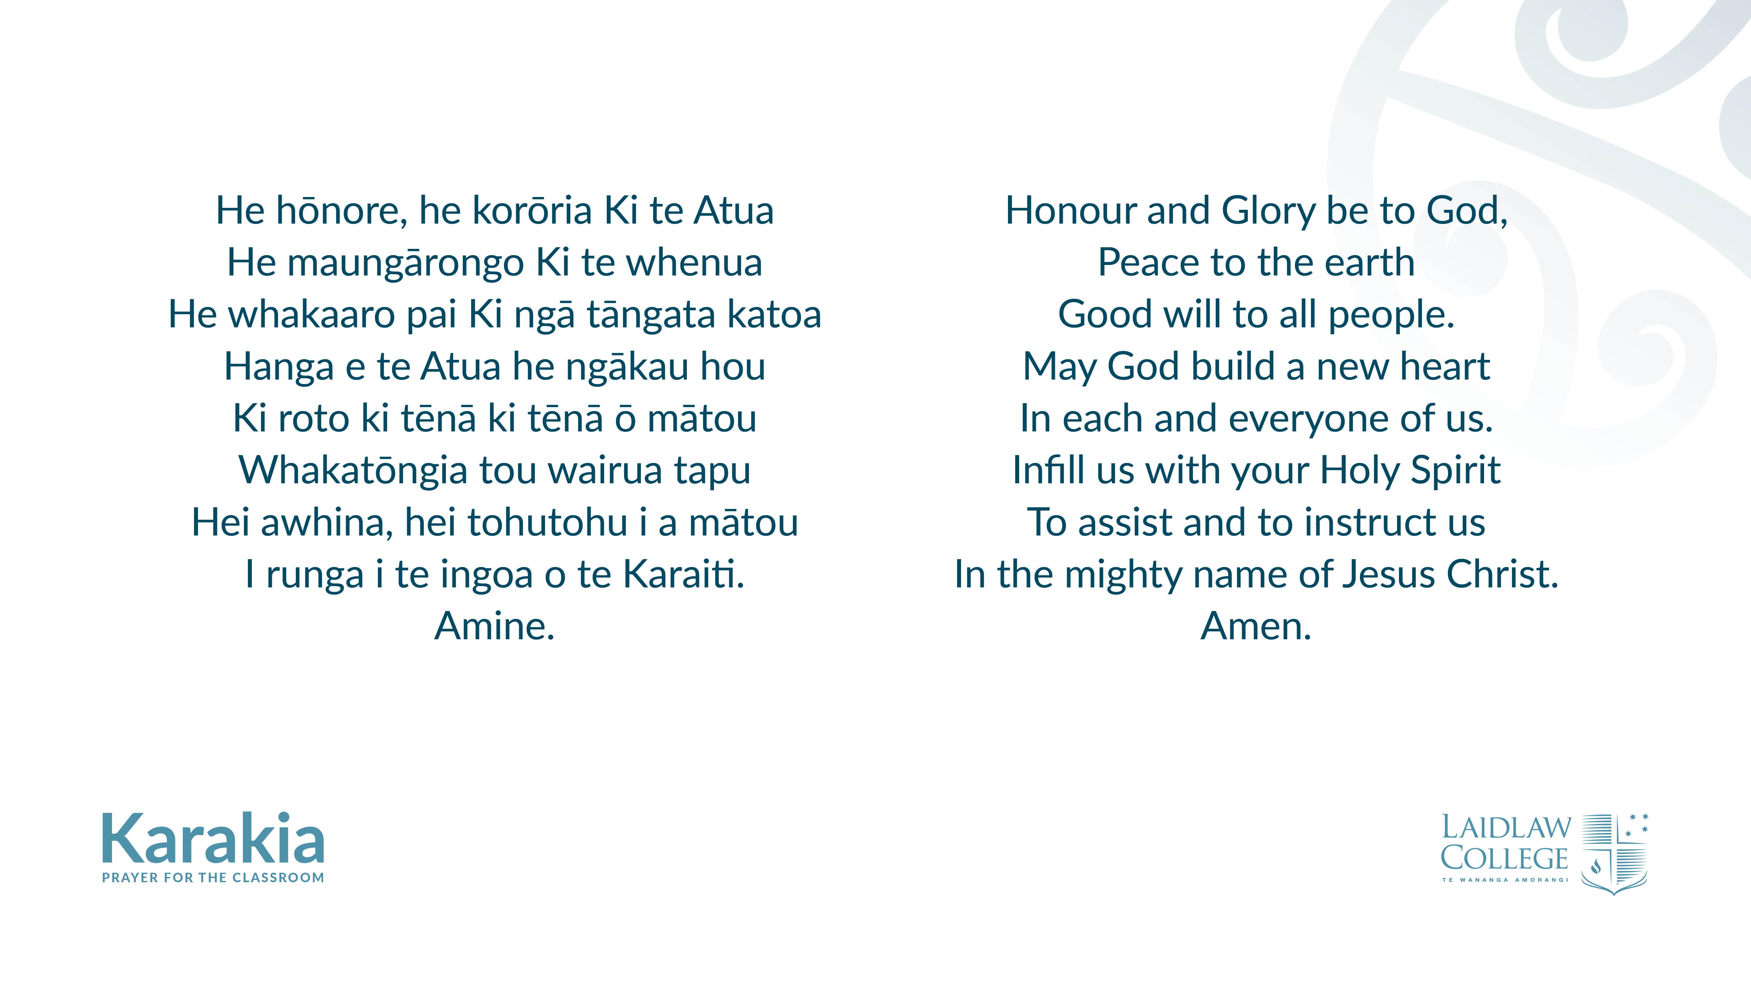

Slide 3
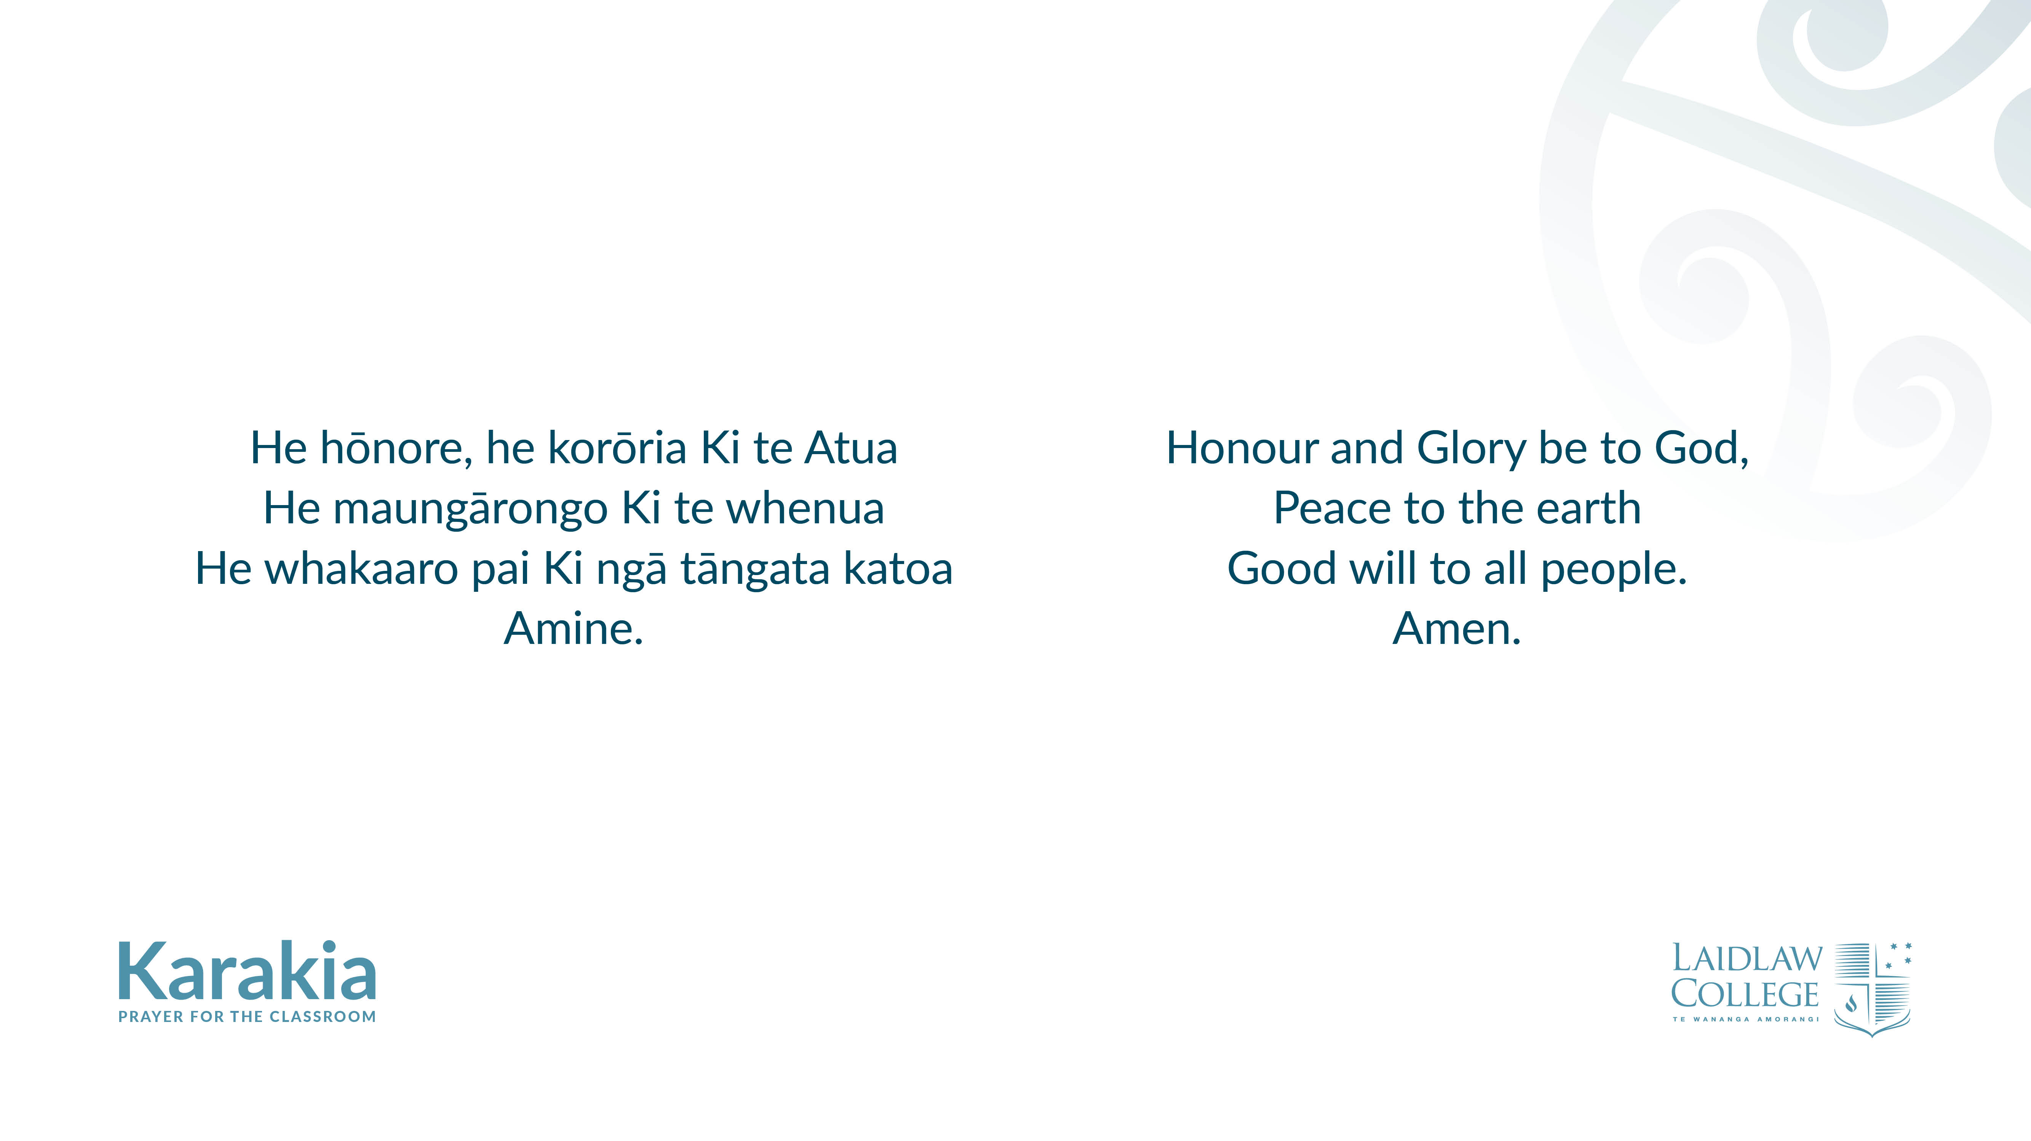

Slide 4
